Slide 1
TEAM DETAILS
RINCY MARIAM THOMAS
M.PRAVACHANA
R.NEHA
P.SUPRIYA
RANIA KHAN
SIMRANPREET KAUR CHAWLA

Slide 2
PROJECT NAME
SUSPICIOUS DETECTION POWERED BY
ARTIFICIAL INTELLIGENCE

Slide 3
MOTIVATION FOR CHOOSING THE PROJECT
The current technology doesn’t allow the cops to get information about the crime as and when it happens so there is a delay in response. To tackle this problem we came up with an idea to develop an app that sends a notification to the nearest police station at the instant when the crime happens and helps get a quick response.

Slide 4
REQUIREMENTS FOR DOING THE PROJECT
We used MIT app inventor to create the app.
Visual Recognition service in IBM cloud to train and test the model to recognize the crimes.

Slide 5



UPLOADING A PICTURE

Slide 6
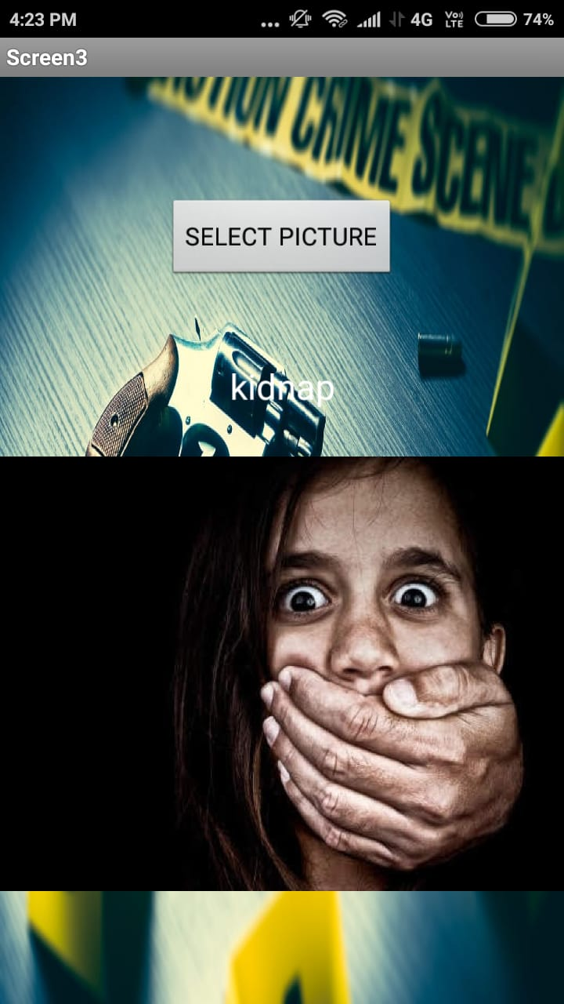
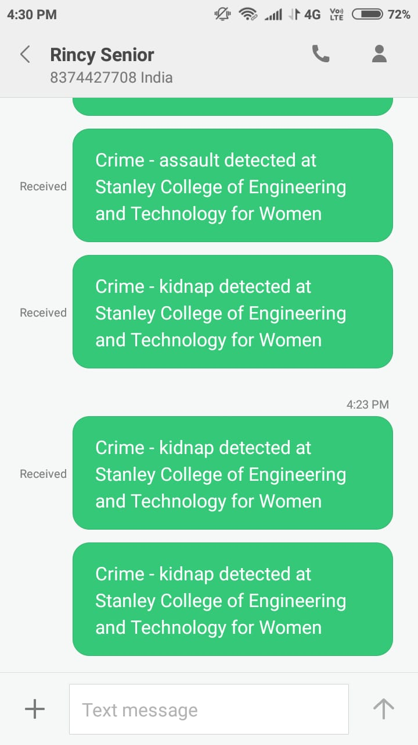

Slide 7

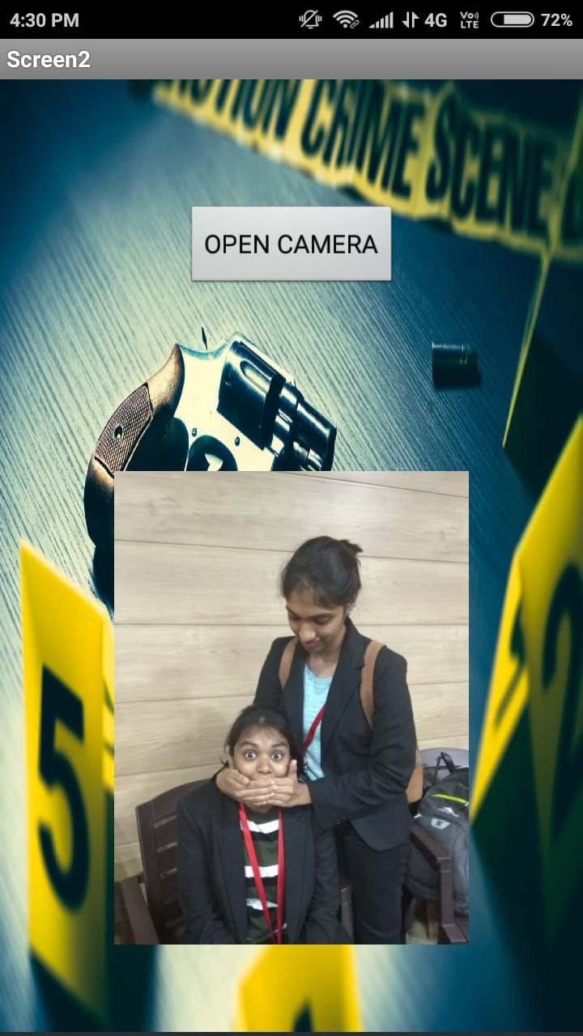
TAKE A PICTURE

Slide 8


Slide 9
ADVANTAGES AND SCOPE
SECURITY INCREASES,CRIME DECREASES
USED TO GET INSTANT RESPONSE FROM POLICE STATIONS.

Slide 10
THANK YOU

